Slide 1
Dashboard for: Arizona_Election_Project written Within Tableau
by Darlington L Ezeuduji, Franklin,Joshua Zaragoza and Raymond Grymko

Slide 2
Description of Data Exploration
The primary data source for this project will be the proprietary statewide voter file provided from the Arizona Democratic Party. While the access to this data is from by a partisan organization, the data itself is neutral. As mentioned, each district consists of 120,000 registered voters. Thus, our model will be compiled of roughly 720,000 rows of data. The initial database will have the following columns:
Voter registration ID
Voter ID
First and last name
Address
City
County
Zip Code
Phone number (75% of voters provide this)
Political Party
Legislative District
Congressional District
Gender
Age
Ethnicity/Race
Voting History
Partisan Score (each voter scored on the degree with which they will vote for their own party)
Turnout Score (likelihood of voting)
Kids in Household (whether they have kids in their house)
Liberal Ideology (how ideological or pragmatic each voter is in their support of Liberal issues)

Slide 3
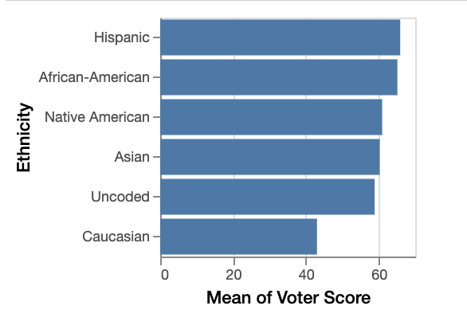
The graph above demonstrates that far and away "Caucasion" and "Uncoded"(meaning unknown) voters have a mean "Voter Scores" most aligned with what has been defined as a Swing Voter. This does not mean that every Caucasion or Uncoded voter are Swing Voters, rather that White voters have the largest range of "Voter Scores" compared to Hispanic, Black, Native American and Asian voters. This is true because Black and Hispanic voters heavily skewed towards the Democratic party. If you look at registration numbers, Black and Hispanic voters are registered with the Democratic Party 91 and 67 percent respectively.

Slide 4
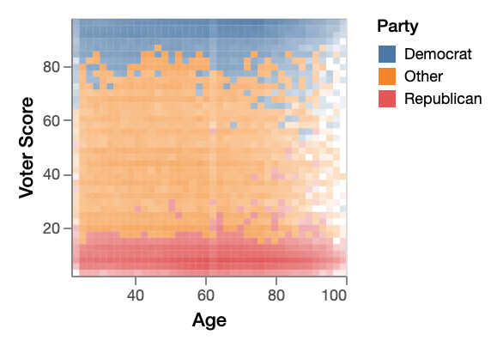
The graph above illustrates another critical element about Swing Voters in our districts. Over the last 20 years, Arizona politics like National politics has become more and more tribal. If you're a Democrat, you must be registered as a Democrat and vote for Democrats unconditionally and vise versa for Republicans. This graph shows that most Democrats have scores between 66-100 while most Republicans have scores between 0-34, regardless of age. As for Others/Independents, they do in fact fall in between the scores of 35-65, whereas roughly 5 percent of Democrats and Republicans are sprinkled in the Swing Voter scores of 35-65.

Slide 5
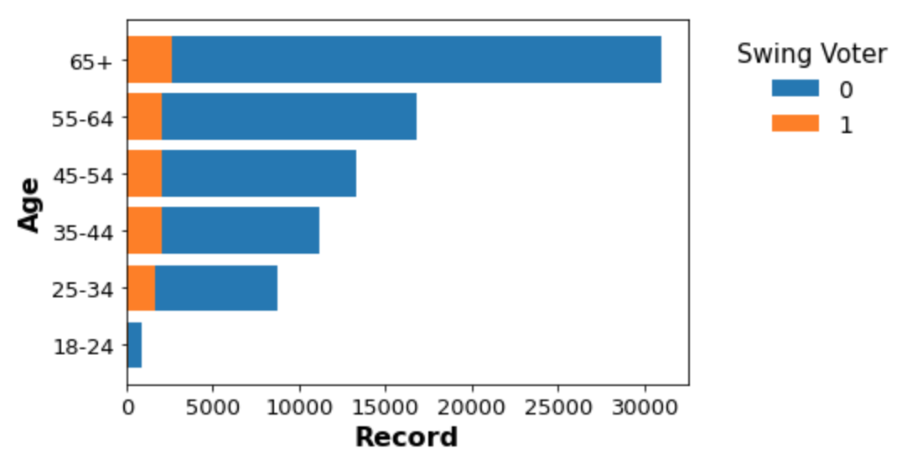
This graph above looks at the relationship between number of Swing Voters fall in each age bracket. The "1" is for a "High Chance" Swing Voter and the "0" is for a "Low Chance" Swing Voter. We broke down ages like this because this is how polling and the political industry buckets ages for audience targeting. This graph highlights that voters between ages of 25-54 have the most voters proportional to highly partisan voters. Specifically, voters between 25-44 have the highest proportionality and if you're spending money communicating with Swing Voters, this age group would be the most cost efficient. On the other side of that, voters over the age of 65 would be the most inefficient. We presume this age disparity of Swing Voters is likely because as people get older they are more likely to get set in their ways and are harder to persuade or unlikely to change their minds, especially on a topic that invokes such hostility like Politics.

